Slide 1
CS5560 Knowledge Discovery and Management
Spark
References:
Spark programming guide http://spark.apache.org/docs/latest/quick-start.html
Introduction to Spark: http://stanford.edu/~rezab/sparkclass/slides/itas_workshop.pdf

Slide 2
Spark vs. Hadoop
Spark is an open source cluster computing environment similar to Hadoop, developed at the University of California, Berkeley
Machine Learning
Spark Streaming
Faster Batch
Spark enables in-memory distributed datasets that optimize iterative workloads in addition to interactive queries.
Spark is complementary to Hadoop and can run side by side over the Hadoop file system.
Spark supports to build large-scale and low-latency data analytics applications.
http://www.ibm.com/developerworks/library/os-spark/

Slide 3
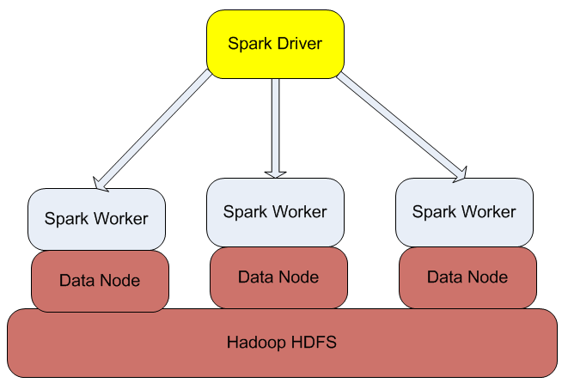
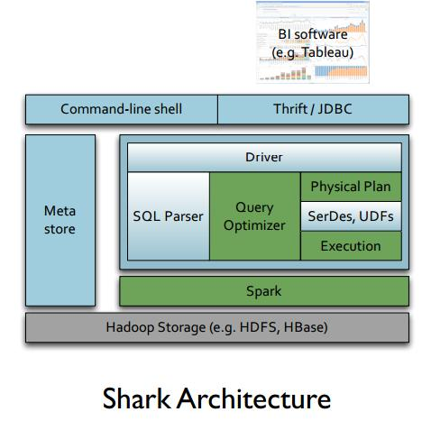
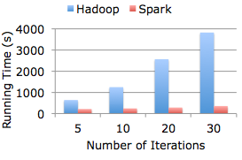
Hadoop/Spark Architecture
up to 100 times faster.
http://www.datasciencecentral.com/profiles/blogs/spark-shark-and-mesos-data-analytics-stack
https://bighadoop.wordpress.com/2014/04/03/apache-spark-a-fast-big-data-analytics-engine/

Slide 4
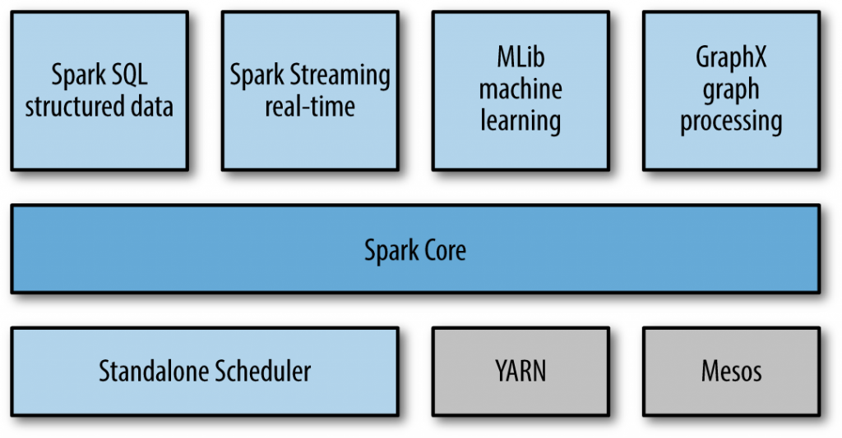
Spark Architecture
http://malsolo.com/blog4java/?p=679

Slide 5
Spark Components
Spark Core: A high level programming framework
These steps are define by RDD (Resilient Distributed Datasets)
The main programming abstraction that represent a collection of items distributed across many compute nodes that can be manipulated in parallel.
Spark SQL: for querying data via SQL.
Spark Streaming: for real-time processing of live streams of data.
GraphX: a library for manipulating graphs and performing graph-parallel computations.
MLLib: a library for machine learning providing algorithms for doing so (classification, regression, …)
http://malsolo.com/blog4java/?p=679

Slide 6
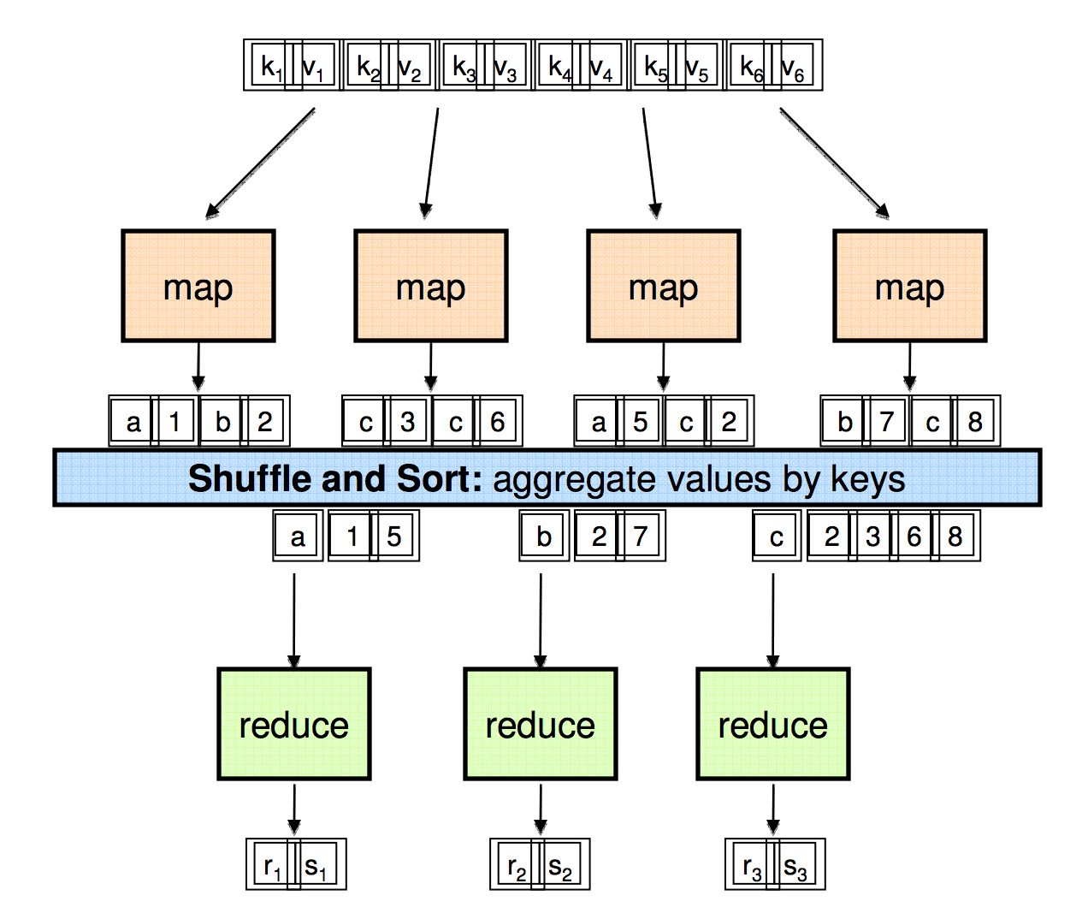
MapReduce

Slide 7
Example: Word Count
def mapper(line):
foreach word in line.split():
output(word, 1)
def reducer(key, values):
output(key, sum(values))

Slide 8
Word Count Execution
Input
Map
Shuffle & Sort
Reduce
Output
the, 1
brown, 1
fox, 1
the quick
brown fox
brown, 2
fox, 2
how, 1
now, 1
the, 3
Map
Reduce
the, 1
fox, 1
the, 1
the fox ate the mouse
Map
quick, 1
how, 1
now, 1
brown, 1
ate, 1
cow, 1
mouse, 1
quick, 1
ate, 1
mouse, 1
Reduce
how now
brown cow
Map
cow, 1

Slide 9
1. Search
Input: (lineNumber, line) records
Output: lines matching a given pattern
Map: if(line matches pattern): output(line)
Reduce: identity function
Alternative: no reducer (map-only job)

Slide 10
2. Sort
Input: (key, value) records
Output: same records, sorted by key
Map: identity function
Reduce: identify function
Trick: Pick partitioning function p such that k₁ < k₂ => p(k₁) < p(k₂)
Map
ant, bee
Reduce
[A-M]
zebra
aardvark
ant
bee
cow
elephant
cow
Map
pig
Reduce
[N-Z]
aardvark,
elephant
pig
sheep
yak
zebra
Map
sheep, yak

Slide 11
3. Inverted Index
Input: (filename, text) records
Output: list of files containing each word
Map: foreach word in text.split(): output(word, filename)
Combine: uniquify filenames for each word
Reduce: def reduce(word, filenames): output(word, sort(filenames))

Slide 12
Inverted Index Example
hamlet.txt
to, hamlet.txt
be, hamlet.txt
or, hamlet.txt
not, hamlet.txt
to be or not to be
afraid, (12th.txt)
be, (12th.txt, hamlet.txt)
greatness, (12th.txt)
not, (12th.txt, hamlet.txt)
of, (12th.txt)
or, (hamlet.txt)
to, (hamlet.txt)
12th.txt
be, 12th.txt
not, 12th.txt
afraid, 12th.txt
of, 12th.txt
greatness, 12th.txt
be not afraid of greatness

Slide 13
4. Most Popular Words
Input: (filename, text) records
Output: the 100 words occurring in most files
Two-stage solution:
Job 1:
Create inverted index, giving (word, list(file)) records
Job 2:
Map each (word, list(file)) to (count, word)
Sort these records by count as in sort job
Optimizations:
Map to (word, 1) instead of (word, file) in Job 1
Estimate count distribution in advance by sampling

Slide 14
5. Numerical Integration
Input: (start, end) records for sub-ranges to integrate
Can implement using custom InputFormat
Output: integral of f(x) over entire range
Map: def map(start, end): sum = 0 for(x = start; x < end; x += step): sum += f(x) * step output(“”, sum)
Reduce: def reduce(key, values): output(key, sum(values))

Slide 15

Spark: Master and Clusters
master connects to a cluster manager to allocate resources across applications
acquires executors on cluster nodes – processes run compute tasks, cache data
sends app code to the executors
sends tasks for the executors to run

Slide 16
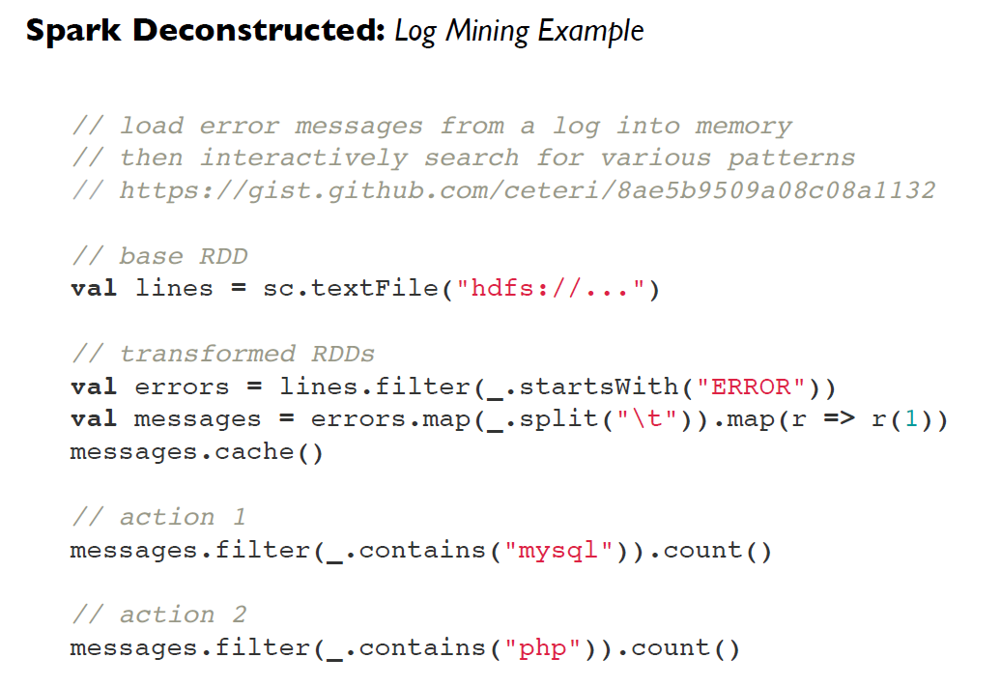

Slide 17
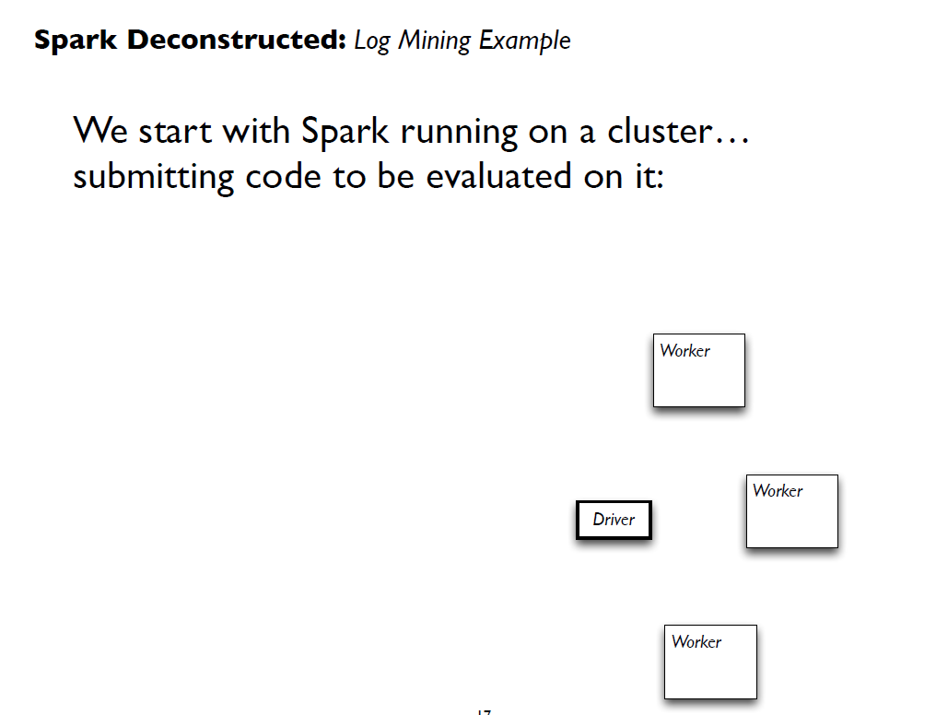

Slide 18
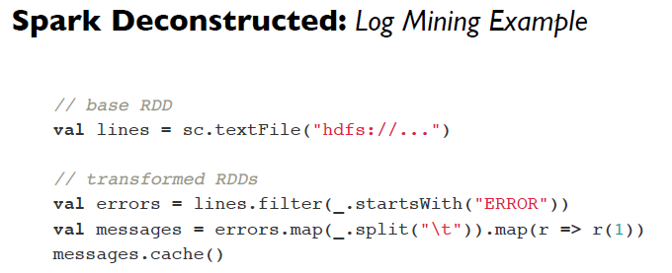
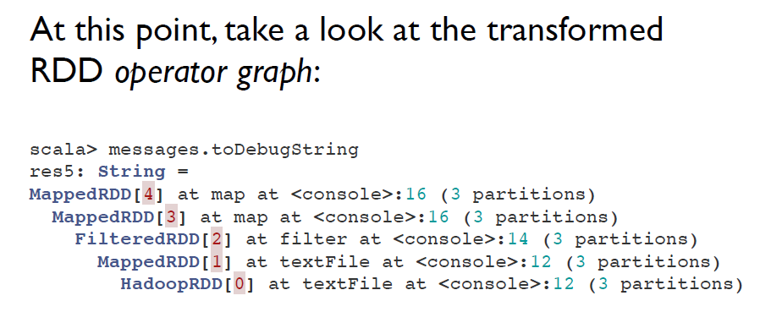

Slide 19
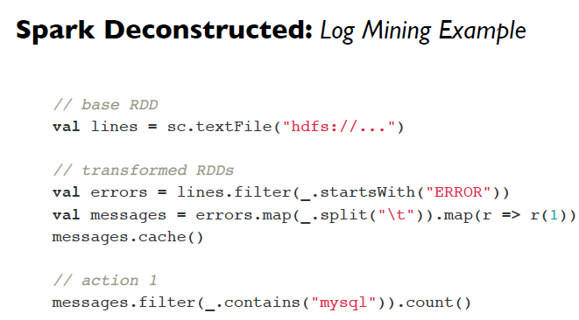
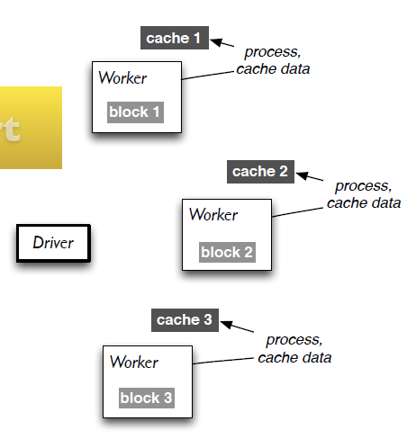
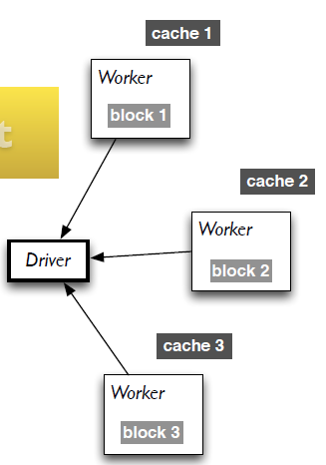
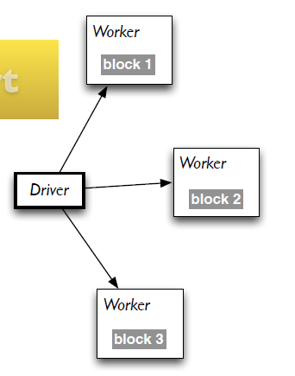
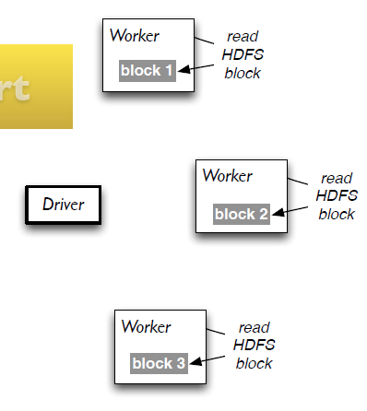

Slide 20
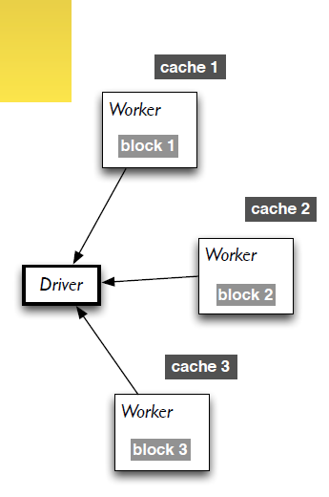
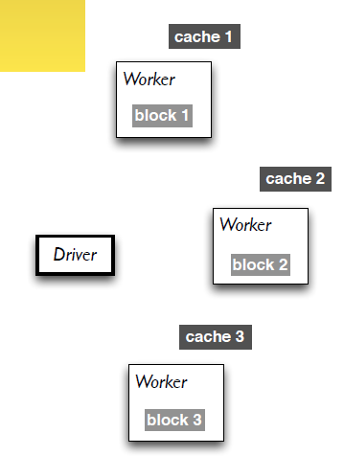
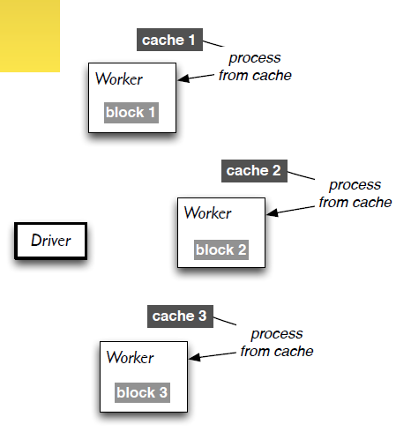


Slide 21
Spark: Resilient Distributed Datasets (RDD)
RDD - the primary abstraction in Spark – a fault-tolerant collection of elements that can be operated on in parallel
There are currently two types:
parallelized collections – take an existing Scala collection and run functions on it in parallel
Hadoop datasets – run functions on each record of a file in HDFS or any other storage systems
Spark can create RDDs from any file stored in HDFS or Amazon S3, Hypertable, HBase, etc.

Slide 22
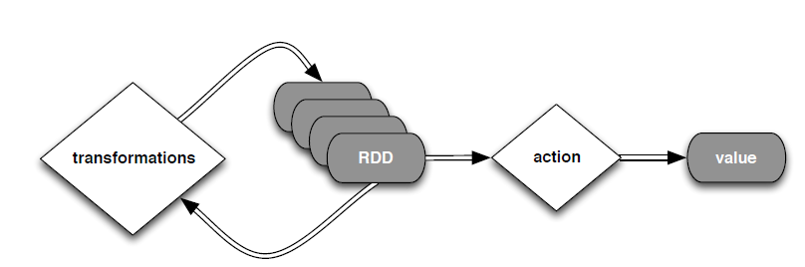
Spark: Resilient Distributed Datasets (RDD)
Two types of operations: transformations and actions
Transformations are lazy (not computed immediately)
The transformed RDD gets recomputed when an action is run.
RDD can be persisted into storage in memory or disk

Slide 23
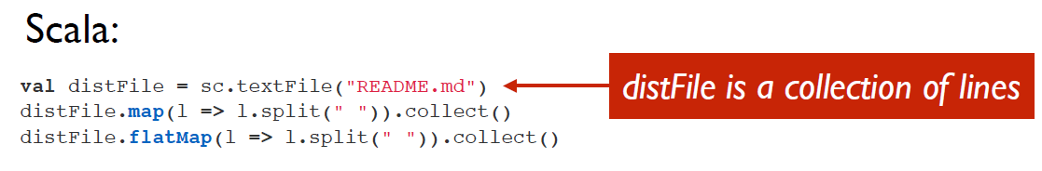
Spark: Transformations
Transformations create a new dataset from an existing one
All transformations in Spark are lazy: remember the transformations applied to some base dataset
optimize the required calculations
recover from lost data partitions

Slide 24
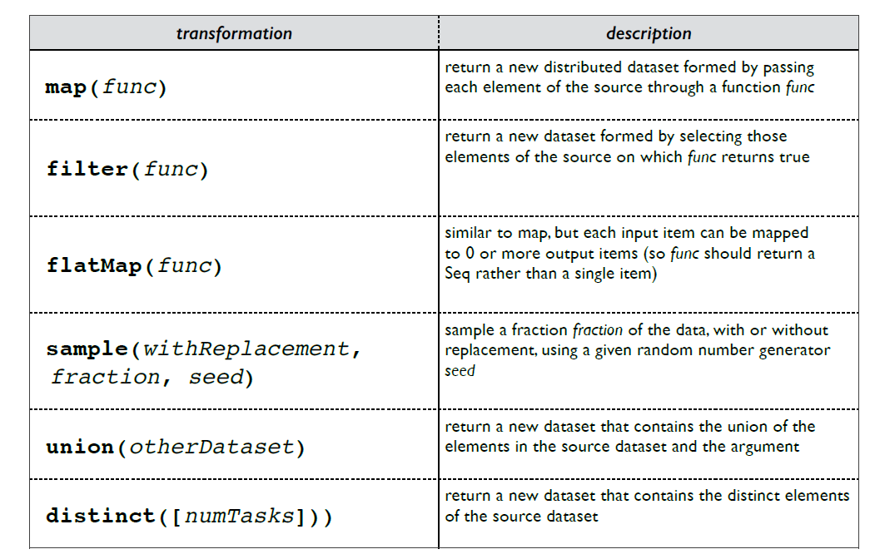
Spark: Transformations

Slide 25
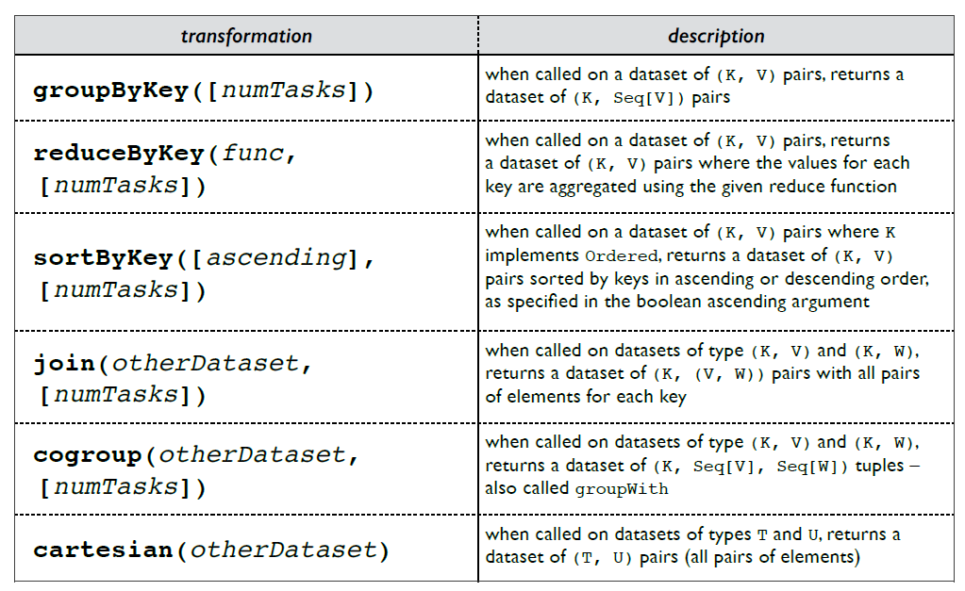
Spark: Transformations

Slide 26
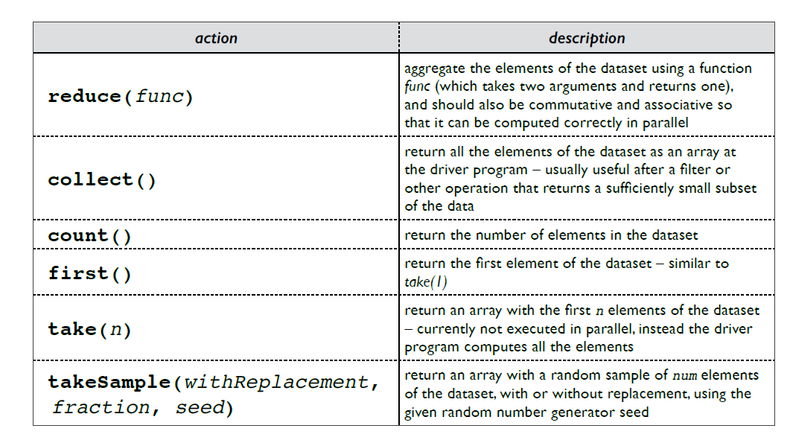
Spark: Actions

Slide 27
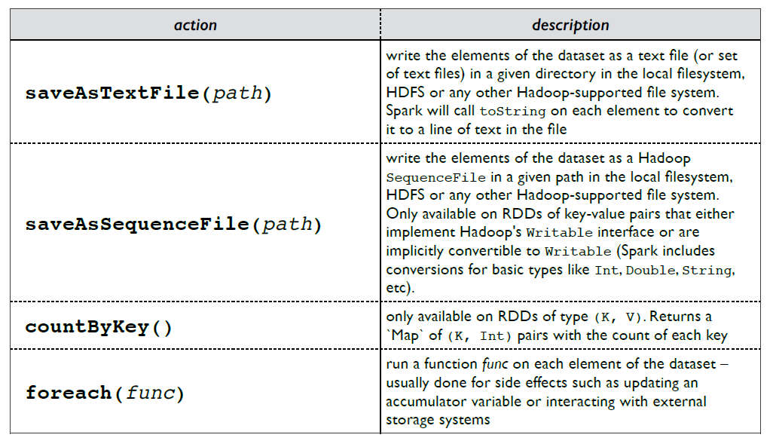
Spark: Actions

Slide 28
Spark: Persistence
Spark can persist (or cache) a dataset in memory across operations
Each node stores in memory any slices of it that it computes and reuses them in other actions on that dataset – often making future actions more than 10x faster
The cache is fault-tolerant: if any partition of an RDD is lost, it will automatically be recomputed using the transformations that originally created it

Slide 29
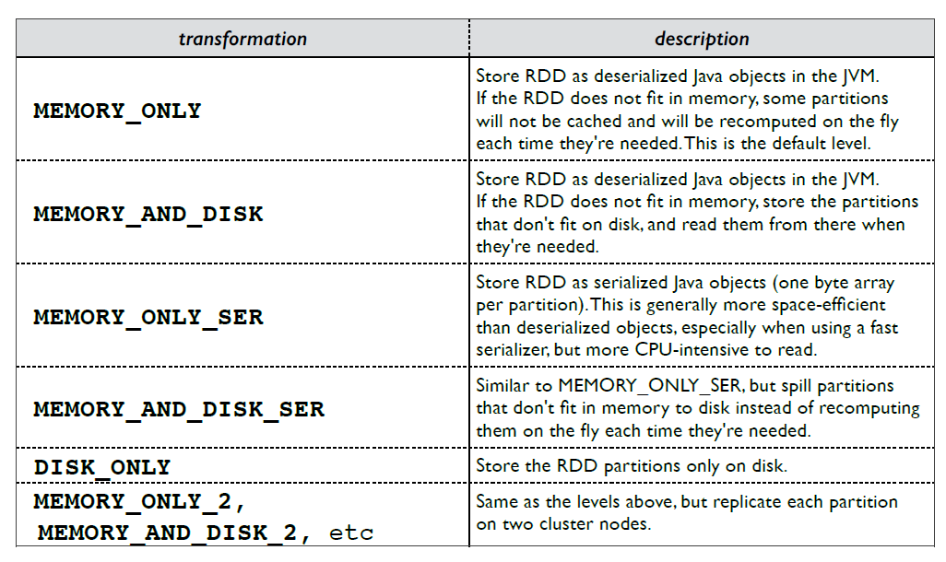
Spark: Persistence
http://spark.apache.org/docs/latest/programming-guide.html#rdd-persistence

Slide 30
Spark: Broadcast variables
Broadcast variables let programmer keep a read-only variable cached on each machine rather than shipping a copy of it with tasks
E.g., to give every node a copy of a large input dataset efficiently
Spark also attempts to distribute broadcast variables using efficient broadcast algorithms to reduce communication cost

Slide 31
Spark: Accumulators
Accumulators are variables that can only be “added” to through an associative operation
Used to implement counters and sums, efficiently in parallel
Spark natively supports accumulators of numeric value types and standard mutable collections, and programmers can extend for new types
Only the driver program can read an accumulator’s value, not the tasks

